Slide 1
REAL-TIME DRIVER DROWSINESS DETECTION SYSTEM USING EYE ASPECT RATIO AND EYE CLOSURE RATIO

Slide 2
TEAM
Bhanu Prasad Kommula (17D41A05A9)
Ponnada Ganesh Nagasai (17D41A05B2)
Rahul Kairamkonda (17D41A0595)
Kiran Jubre (17D41A0587)
Under the supervision of
Mr. SNVASRK PRASAD

Slide 3
PRESENTATION OUTLINE
Introduction
Objectives – Existing System, Proposed System
Technology Platform Overview
System Requirements
Application Features Overview
Implementation
Application Snapshots
Result
Future Work
Conclusion

Slide 4

INTRODUCTION
Roughly around 17 accident- related deaths occur
around India every hour and almost around 1214 accidents
everyday. Most of these accidents are caused during night
due driver drowsiness and fatigue.
So, developing and maintaining technologies which can efficiently detect or prevent drowsiness and alert the driver before any mishap is a challenging task. But modern technologies made this challenging task easy.

Slide 5
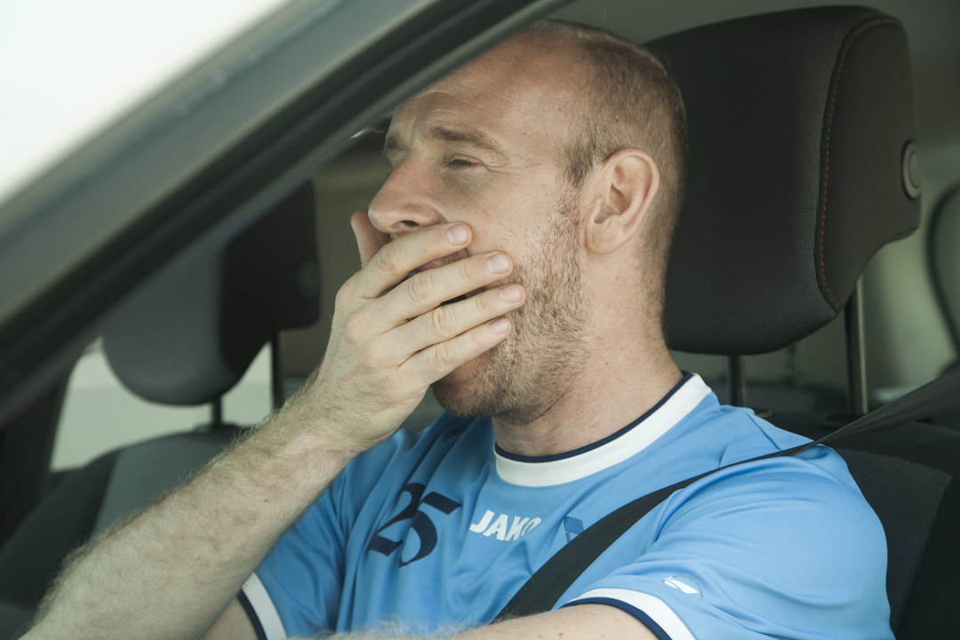
Using modern technologies along with real time scanning systems using camaras we can prevent major mashup by alerting the drive who Is feeling drowsy.
Our main idea is to monitor the eyes, it is believed that the symptoms of driver fatigue can be detected early enough to avoid accident. Detection of fatigue involves the observation of eye movements and blink patterns in a sequence of images of a face.

Slide 6
Existing system
Accidents due to drowsiness can be controlled and prevented with the help of eye blink sensor using IR rays. It consists of IR transmitter and an IR receiver. The transmitter transmits IR rays into the eye. If the eye is shut, then the output is high. If the eye is open, then the output is low. This output is interfaced with an alarm inside and outside the vehicle. This module can be connected to the braking system of the vehicle and can be used to reduce the speed of the vehicle. The alarm inside the vehicle will go on for a period of time until the driver is back to his senses. If the driver is unable to take control of the vehicle after that stipulated amount of time, then the alarm outside the vehicle will go on to warn and tell others to help the driver.

Slide 7
Proposed system
In this project by monitoring Visual Behaviour of a driver with webcam algorithm we are detecting Drowsiness in a driver. This application will use inbuilt webcam to read pictures of a driver and then using OPENCV Cascade Classifier to extract facial features from the picture and then check whether driver in picture is blinking his eyes for consecutive 20 frames or yawning mouth then application will alert driver with Drowsiness. are continuously checking or predicting EYES and MOUTH distance closer to drowsiness, if distance is closer to drowsiness then application will alert driver.

Slide 8
Platform Technology
In the developed system, a webcam records the video and driver’s face is detected in each frame employing image processing techniques. Facial landmarks on the detected face are pointed and subsequently the eye aspect ratio, mouth opening ratio and nose length ratio are computed and depending on their values, drowsiness is detected based on developed adaptive thresholding.

Slide 9
Workflow
Image sequence input
Face detection
Eye detection
Eye shape tracking
Eye closed ?
No yes
alert

Slide 10
System Requirements
HARDWARE REQUIREMENTS:
  System : intel I3 2.4 GHz. Or Advanced
  Hard Disk : 200 GB +
  Monitor : 14’ Colour Monitor. Or Advanced
  Mouse : Optical Mouse.
  Ram : 4GB +
  GPU : 2GB +

Slide 11
Software Requirments
Python (3.6 version recommended) installed on your system
Using PIP we have to install following softwares :
OpenCV – pip install opencv-python (face and eye detection).
      (version 4.1.0 and above)
TensorFlow – pip install tensorflow (TensorFlow as backend).
Pygame – pip install pygame (to play alarm sound)
Numpy – pip install numpy(to get the coordinates of the face)

Slide 12
Application Features
Application can be implemented at low cost.
Most accurate than existing system.
Can be integrated with other tasks if needed.
Works in any situation.
Less infrastructure need.
Easily fits to any type of vehicle.

Slide 13
Implementation
Drowsy driving is one of the main causes of traffic accidents. Since drivers cannot react to dangerous situations when drowsy, major accidents can occur. To prevent accidents due to drowsy driving, it is necessary to detect driver drowsiness early and accurately. So we came up with an application called ‘REAL-TIME DRIVER DROWSINESS DETECTION SYSTEM’.
Face can also be considered as object so this object can be detected using OpenCV by using face detection techniques based on object detection.
Cascade Classifier is a machine learning based approach used to detect objects in images and videos. So in our case Cascade Classifier is used for face detection.

Slide 14


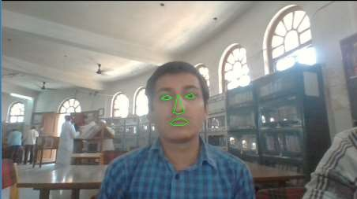
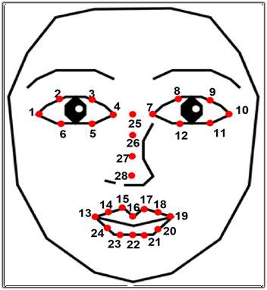

Slide 15
Computer vision with Cascade Classifier is hence used to capture the face, left eye, and right eye from all other objects in the video. A file named cnncat2.h5 contains the closed and opened images of eyes. Using Keras library live frames of eyes and stored images are compared.
In the case of the eyes closed, the score value increases by 1. To avoid the case in which the driver blinks, the system waits 15 seconds. If no changes detected an alarm sets off. This alarm stops once the score falls below 24.

Slide 16


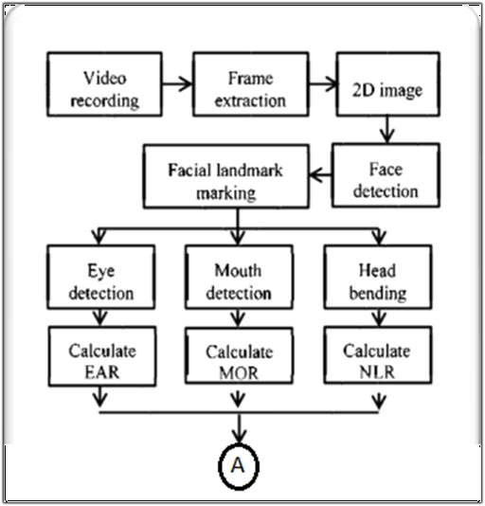
Implementation Architecture

Slide 17
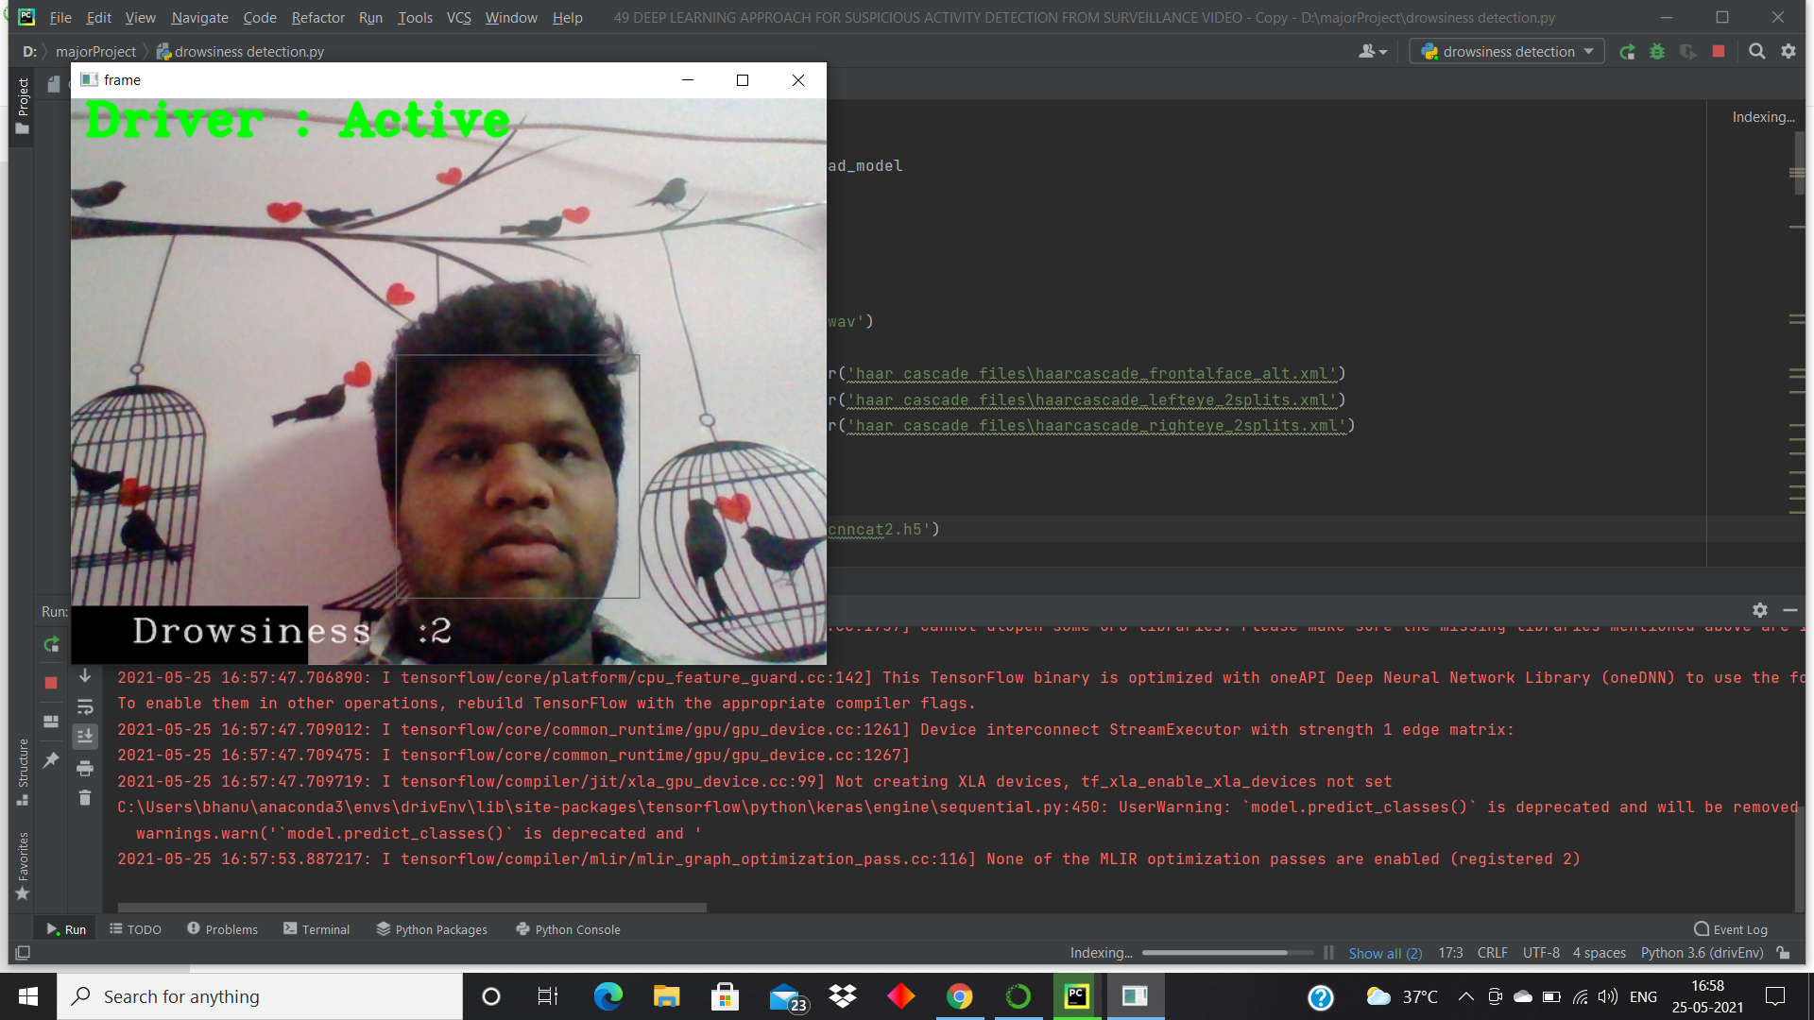
Snapshots

Slide 18
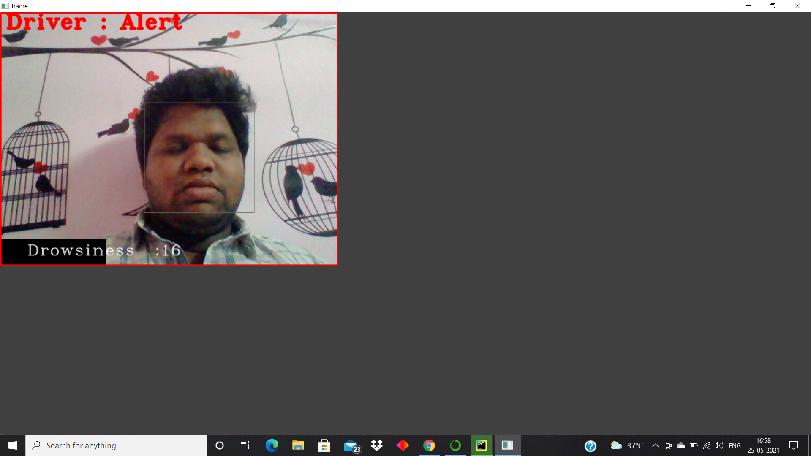

Slide 19
Result
When the eye opening ratio is less, then alert system in the vehicle is activated and that will wake the driver and prevents major accidents.
Alarm automatically stops when driver is active.
Showed good accuracy rate.
Captures a snap of driver will drowsy.

Slide 20
Future Work
In future we are planning to extend the application by integrating it with a breaking system so that the vehicle can be slowed down. It triggers when the driver is not active even after alerting for 120 seconds.
While slowing down the vehicle, parking lights are also activated simultaneously which helps surrounding people to notice.

Slide 21
Conclusion
The implementation of Driver Drowsiness detection system is done by combining algorithms and tools like Face detection technique, Cascade Classifier, OpenCV, Python, Machine Learning algorithm, Camera, Audio emitter.
This Drowsiness detection system works accurately by detecting the face and the eyes of driver and in the case of detecting low eye open ratio activates the alarm system alerting the driver preventing major accidents.

Slide 22
ANY QUERRIES ?

Slide 23
Thank You

